Slide 1
Recap: Lecture 2, 7TH January 2014, 0830-0930 hrs.
Property
Intensive, extensive, specific properties
State of a system
Equilibrium
Mechanical, thermal, chemical, phase and Thermodynamic equilibrium
State postulate
Process, path and cycle
Quasi-static/quasi-equilibrium processes
Energy
Kinetic energy, Potential energy, total energy
Microscopic and Macroscopic energy

Slide 2
Energy
Energy can exist in numerous forms such as thermal, mechanical, kinetic, potential, electric, magnetic, chemical, and nuclear
The sum total of the above: Total energy, E
e = E/m kJ/kg
Thermodynamics provides no information about the absolute value of the total energy.
It deals only with the change of the total energy, which is what matters in engineering problems.

Slide 3
Energy
Forms of energy:
Macroscopic energy: Energy that a system possesses as a whole with respect to some outside reference frame, eg: Kinetic Energy, Potential Energy
Microscopic energy: These are related to the molecular structure of a system and the degree of the molecular activity and are independent of the outside reference frames
Sum of all microscopic forms of energy of a system: Internal energy, U (kJ) or u = U/m (kJ/kg)

Slide 4
Macroscopic energy
The macroscopic energy, KE and PE, of an object changes with velocity and elevation.

Slide 5
Internal energy
Sensible energy: Part of the internal energy associated with kinetic energy of molecules
Rotational KE, translational KE, vibrational KE
Latent energy: Internal energy associated with phase change of a system
Chemical energy: Internal energy associated with the atomic bonds in a molecule
Nuclear energy: Tremendous amount of energy associated with the strong bonds within the nucleus of the atom

Slide 6
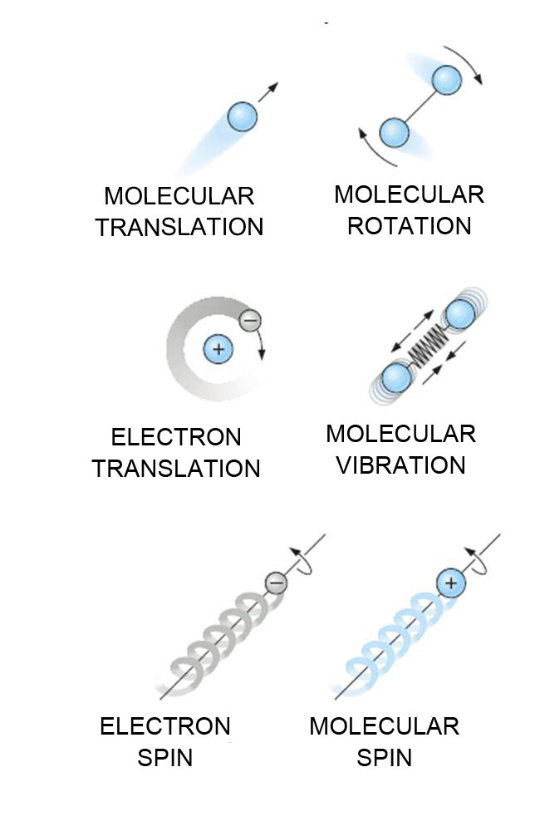
The various forms of microscopic
energies that make up sensible energy.

Slide 7
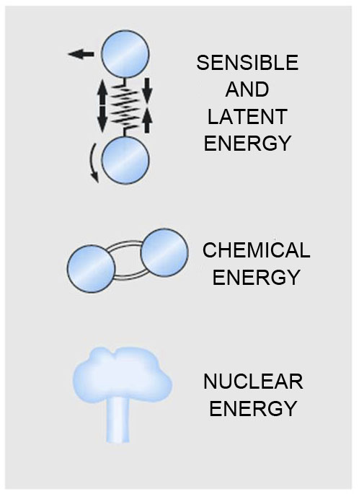
The internal energy of a system is the sum of all forms of the microscopic energies.

Slide 8
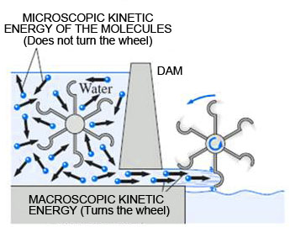
The macroscopic kinetic energy is an organized form of energy and more useful than the disorganized microscopic kinetic energies of the molecules

Slide 9
Kinetic and Potential energies
Kinetic energy, KE, of a system:
Potential energy, PE, of a system:

Slide 10
Total energy of a system
In the absence of magnetic, electric, and surface tension effects, the total energy of a system consists of the kinetic, potential, and internal energies

Slide 11
Total energy of a system
Closed systems whose velocity and elevation of the center of gravity remain constant during a process are frequently referred to as stationary systems.
The change in the total energy E of a stationary system is identical to the change in its internal energy U.

Slide 12
Kinetic and Potential energies
Kinetic energy, KE, of a system:
Potential energy, PE, of a system:

Slide 13
Total energy of a system
In the absence of magnetic, electric, and surface tension effects, the total energy of a system consists of the kinetic, potential, and internal energies

Slide 14
Total energy of a system
Closed systems whose velocity and elevation of the center of gravity remain constant during a process are frequently referred to as stationary systems.
The change in the total energy E of a stationary system is identical to the change in its internal energy U.

Slide 15
Enthalpy
The combination of internal energy u and pv is often encountered in the analysis of control volumes
Enthalpy is a combination property
Enthalpy is also often referred to as heat content
Process in which enthalpy is constant: isenthalpic process

Slide 16
Enthalpy
u₁
Control Volume
p₁ v₁
u₂
p₂ v₂
The combination u+pv is frequently encountered in the analysis of control volumes
Isoenthalpic process:
h₁ = h₂
u₁+ p₁v₁ = u₂ + p₂v₂

Slide 17
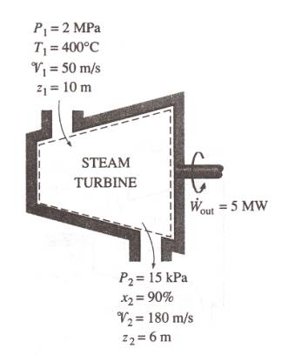
Control volume- Example: Steam turbine
Enthalpy = h₁
Enthalpy = h₂

Slide 18
Zeroth law of thermodynamics
States that “if two bodies are in thermal equilibrium with a third body, they are also in thermal equilibrium with each other”.
It serves as a basis for the validity of temperature measurement.
By replacing the third body with a thermometer, the zeroth law can be restated as two bodies are in thermal equilibrium if both have the same temperature reading even if they are not in contact.

Slide 19
Zeroth law of thermodynamics
Let us say T_{A},T_{B} and T_{C} are the temperatures of A,B and C, respectively.
A and C are in thermal equilibrium: T_{A}=T_{C}
B and C are in thermal equilibrium: T_{B}=T_{C}
Consequence of Zeroth law: T_{A}=T_{B}
A
B
C

Slide 20
Zeroth law of thermodynamics
It was named the zeroth law since it should have preceded (proposed in 1931) the first and the second laws of thermodynamics that were defined in late 1800s.
All temperature scales based on reproducible states: freezing point (ice point) or boiling point of water (steam point).
On the Celsius scale, ice and steam points were assigned 0ºC and 100ºC respectively.

Slide 21
Temperature scales
In thermodynamics, it is desirable to have a temperature scale that is independent of any property of a substance.
Thermodynamic temperature scale or the Kelvin scale
The lowest temperature on this scale is 0 K.
Celsius and Fahrenheit scales are often referred to as two-point temperature scales.

Slide 22
Temperature scales
A temperature scale that turns out to be nearly identical to the Kelvin scale: ideal gas temperature scale.
Measured using a constant volume thermometer
Filled with hydrogen or helium
At low pressures, the temperature of a gas is proportional to its pressure at constant volume.

Slide 23
Ideal gas temperature scales
The temperature of a gas of fixed volume varies linearly with pressure at sufficiently low pressures.
The relationship between the temperature and the pressure of the gas in the vessel can be expressed as
T = a + bP
where the values of the constants a and b for a gas thermometer are determined experimentally.

Slide 24
Ideal gas temperature scale
Measuring the pressures of the gas in the vessel at two reproducible points (such as the ice and the steam points) and assigning suitable values to temperatures at those two points.
These two measurements are sufficient to determine the constants a and b
Then the unknown temperature T of a medium corresponding to a pressure reading P can be determined from that equation by a simple calculation.

Slide 25
Ideal gas temperature scale
If the ice and steam points are assigned the values 0°C and 100°C, respectively, then the gas temperature scale will be identical to the Celsius scale.
In this case the value of the constant a (which corresponds to an absolute pressure of zero) is determined to be -273.15°C regardless of the type and the amount of the gas in the vessel of the gas thermometer.

Slide 26
Ideal gas temperature scale
.
Measured data points
Gas A
P
.
.
.
Gas B
.
.
.
.
Gas C
Extrapolation
.
.
.
.
.
.
.
.
.
Gas D
-273.15
0
T(ºC)
P vs.T plots of the experimental data obtained from a constant-volume gas thermometer using four different gases at different (but low) pressures.

Slide 27
Ideal gas temperature scale
-273.15°C: is the lowest temperature that can be obtained by a gas thermometer, and thus we can obtain an absolute gas temperature scale by assigning a value of zero to the constant a.
In this case, we need to specify the temperature at only one point to define an absolute gas temperature scale.
Standard fixed point for temperature scale: Triple point of water: 0.01⁰C or 273.16K (for Celsius scale)

Slide 28
Ideal gas temperature scale
The absolute gas temperature scale is not a thermodynamic temperature scale, since it cannot be used at very low temperatures (due to condensation) and at very high temperatures (due to dissociation and ionization).
However, absolute gas temperature is identical to the thermodynamic temperature in the temperature range in which the gas thermometer can be used.

Slide 29
“The unit of thermodynamic temperature T, the kelvin (K), defined as the fraction 1/273.16 of the thermodynamic temperature of the triple point of water, which is sole defining fixed point of both the ITS-90 and the Kelvin scale.”
Types of commonly used thermometers:
Constant volume gas thermometer , T(P)
Constant pressure gas thermometer, T(V)
Electric resistance thermometer, T(R)
Thermocouple, T(ε)
Liquid-in-glass thermometer, T(L)

